Slide 1

Olist E-commerce Analytics Dashboard
Bharath Gowda J M

Slide 2
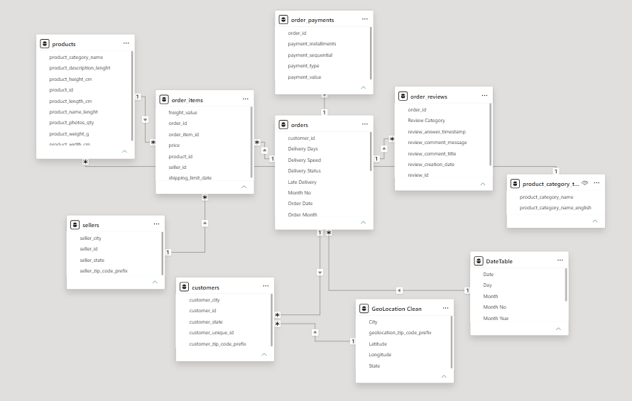
Data Model Architecture
Why Star Schema?
Better Performance
Easier DAX Calculations
Faster Reporting
Scalable Analytics
Implemented a Star Schema model to improve dashboard performance and analytical flexibility.
Fact Tables
Orders
Order Items
Payments
Reviews
Dimension Tables
Customers
Products
Sellers
Date

Slide 3
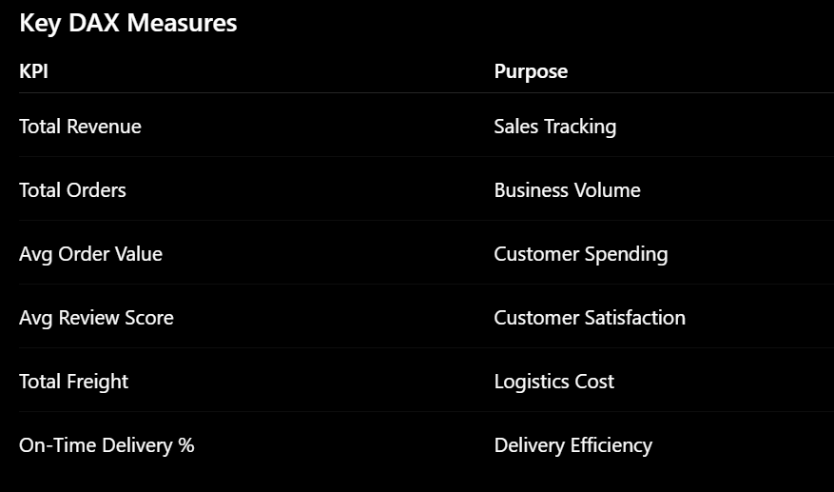
Data Transformation & Dax
DAX was used to transform raw transactional data into business-focused KPIs
Data Preparation
Data Cleaning
Null Handling
Relationship Creation
Date Table Development
Delivery Status
On Time
Late
Not Delivered
Month Year
Used for trend analysis.

Slide 4
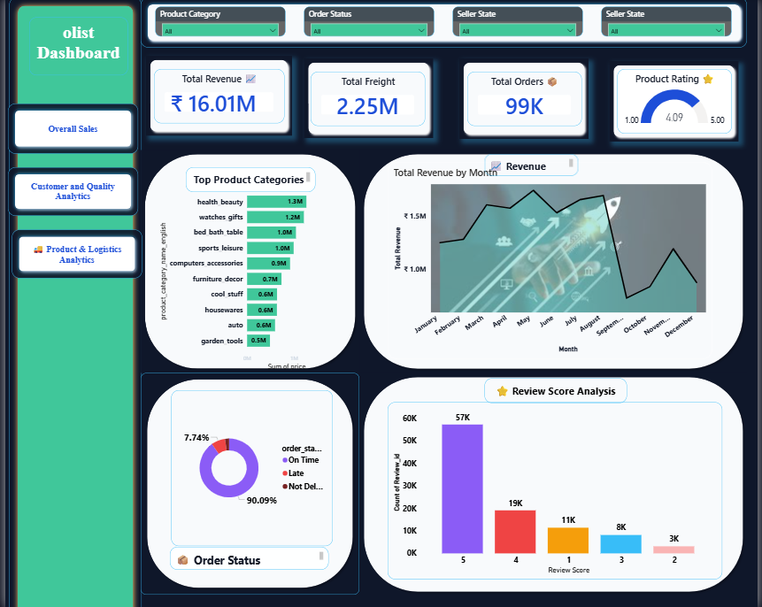
EXECUTIVE OVERVIEW DASHBOARD
Provides a centralized view of overall business performance.
Revenue trends and order performance can be monitored in real time.
KPIs Included
Total Revenue
Total Orders
Total Customers
Total Sellers

Slide 5
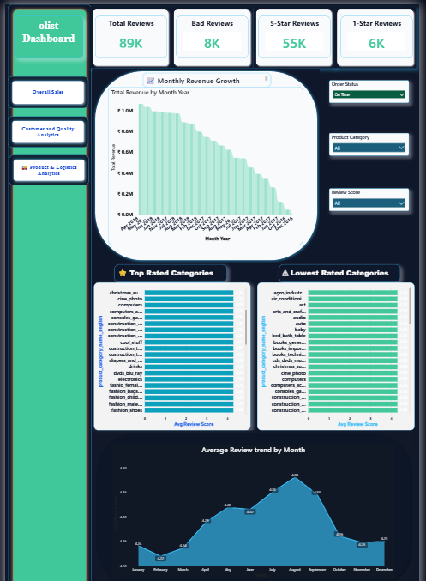
CUSTOMER & QUALITY ANALYTICS
Features:
Review distribution
Customer satisfaction trends
Top rated categories
Low rated categories
Most customers provide positive ratings
Certain categories consistently receive lower ratings
Review trends help identify quality improvement opportunities
Supports customer experience and product quality management

Slide 6
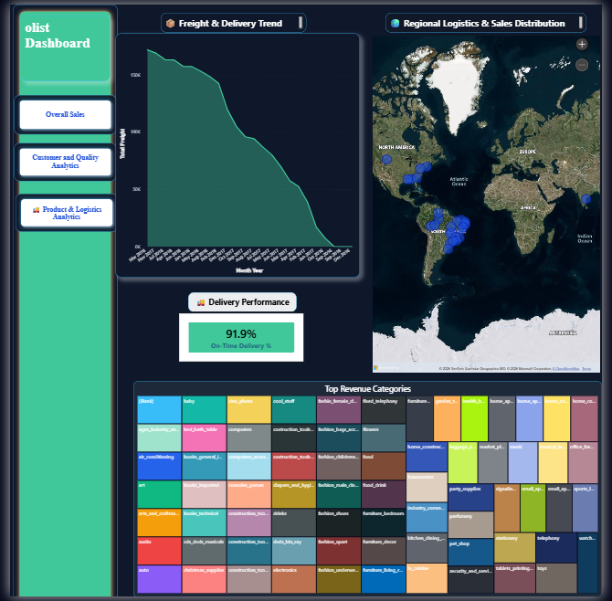
PRODUCT & LOGISTICS ANALYTICS
Features:
Regional Sales Map
Delivery Performance
Freight Trends
Seller Performance
Sales are concentrated in specific regions
Most deliveries are completed on time
Freight costs directly impact operational efficiency
Seller contribution is uneven across the marketplace
Supports logistics optimization and operational decision-making

Slide 7
KEY BUSINESS INSIGHTS
Insight 1 — Revenue Concentration
A small number of product categories generate a significant share of revenue.
Action: Focus inventory and marketing investment on top-performing categories
Insight 2 — Customer Satisfaction
Most reviews fall within higher rating ranges.
Action: Maintain quality standards while addressing low-rated categories.
Insight 3 — Logistics Performance
Majority of orders are delivered on time.
Action: Monitor delayed deliveries to improve customer experience.
Insight 4 — Seller Contribution
A small group of sellers contributes a large portion of revenue.
Action: Develop strategic seller partnerships.
Insight 5 — Regional Opportunities
Revenue is concentrated in a limited number of states.
Action: Explore expansion opportunities in underperforming regions.

Slide 8
CONCLUSION
The Olist Ecommerce Analytics Dashboard successfully transformed raw ecommerce data into an interactive business intelligence solution using Power BI. By leveraging data modeling, DAX measures, and advanced visualizations, the dashboard provides actionable insights into sales performance, customer satisfaction, seller contribution, and logistics efficiency.
This project demonstrates strong skills in Power BI, DAX, data modeling, KPI development, and business storytelling, enabling data-driven decision-making through a modern and user-friendly analytics platform.
Developed business-focused KPIs using DAX and data modeling techniques.
Identified revenue, customer, logistics, and seller performance trends.
Improved data accessibility through intuitive and interactive visual storytelling.
Demonstrated end-to-end Business Intelligence and Data Analytics capabilities

